Slide 1
Multiscale Retinex
Alexander Stanciu

Slide 2
Singlescale Retinex
Single-Scale Retinex output is determined by the difference between the input value and an average of its neighborhood.
The general mathematical form of a Single-Scale Retinex (SSR) is:
Ri(x, y) = log(Ii(x, y)) − log(Ii(x, y) ∗ F(x, y)) where:
Ii = input image on the i-th color channel
Ri = retinex output image on the i-th channel
F = filter (Gaussian filter)
To solve log(0) problem, 1 was added to the whole image

Slide 3
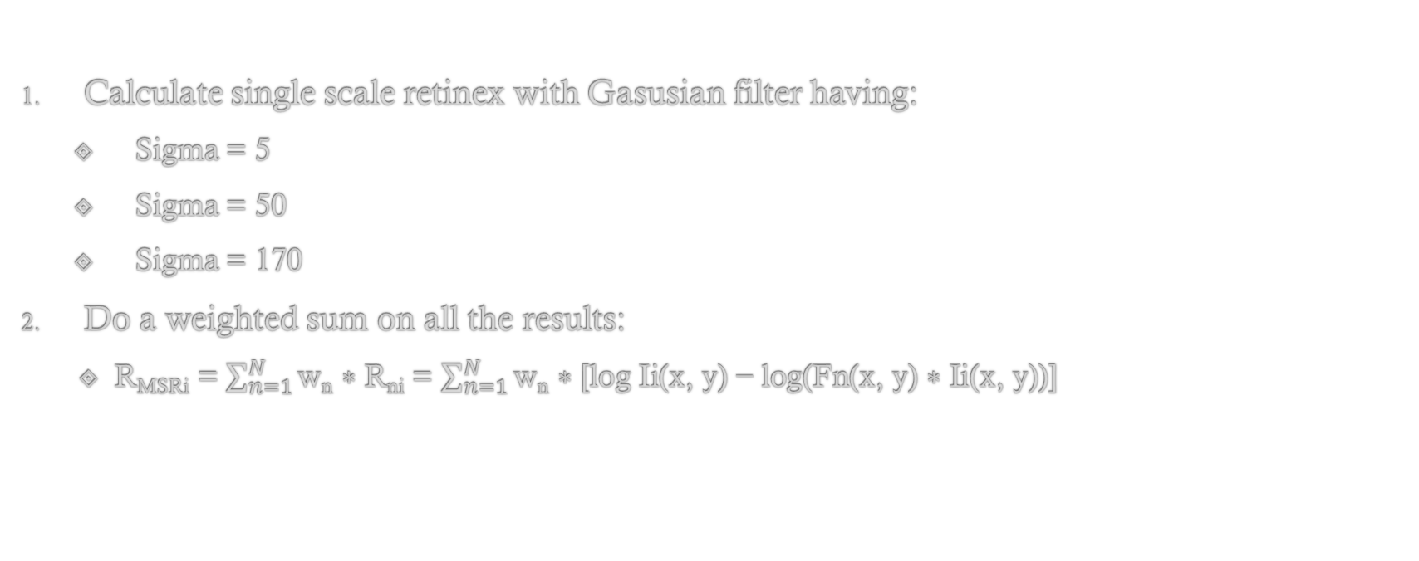
Original Multiscaled Retinex
Calculate single scale retinex with Gasusian filter having:
Sigma = 5
Sigma = 50
Sigma = 170
Do a weighted sum on all the results:
R_{MSRi} = $\sum_{n=1}^{N}{\text{w}\text{n}\text{ ∗ }\text{R}\text{ni}}$ = $\sum_{n=1}^{N}{\text{w}\text{n} \text{∗ }\text{[}\text{log} \text{Ii}\text{(}\text{x}\text{, }\text{y}\text{) − }\text{log}\text{(}\text{Fn}\text{(}\text{x}\text{, }\text{y}\text{) ∗ }\text{Ii}\text{(}\text{x}\text{, }\text{y}\text{))]}}$

Slide 4
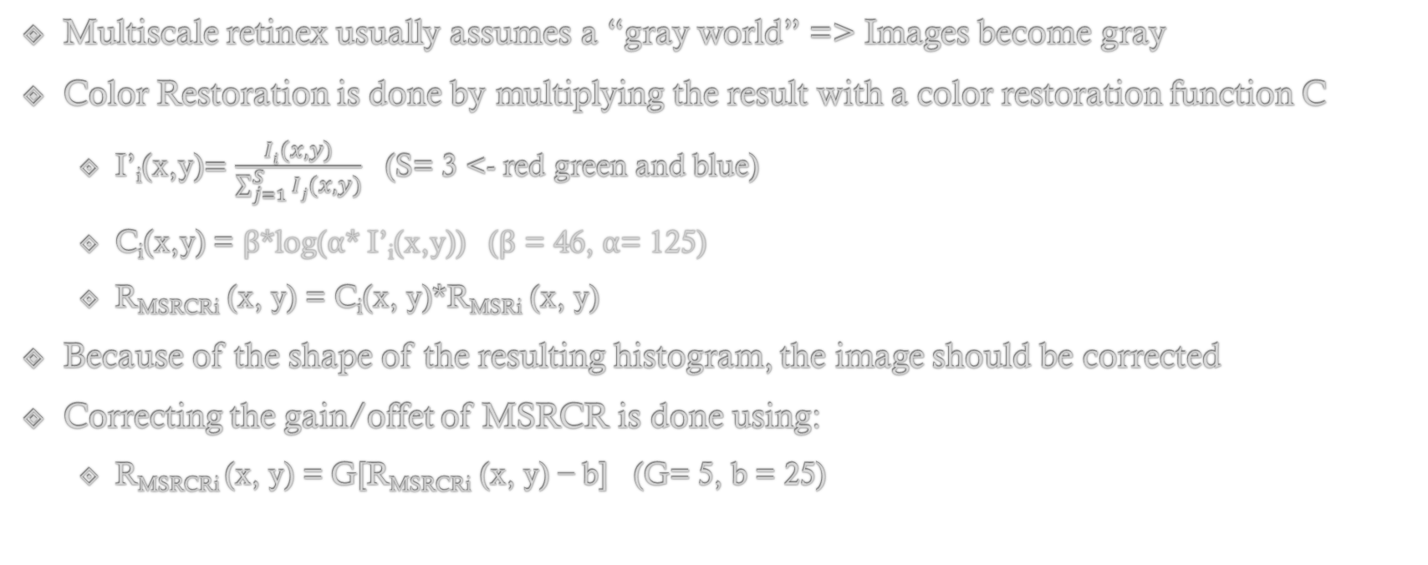
Multiscale Retinex Color Restoration (MSRCR)
Multiscale retinex usually assumes a “gray world” => Images become gray
Color Restoration is done by multiplying the result with a color restoration function C
I’_{i}(x,y)$=\frac{Ii(x,y)}{\sum_{j=1}^{S}{Ij(x,y)}}$ (S= 3 <- red green and blue)
C_{i}(x,y) = β*log(α* I’_{i}(x,y)) (β = 46, α= 125)
R_{MSRCRi} (x, y) = C_{i}(x, y)*R_{MSRi} (x, y)
Because of the shape of the resulting histogram, the image should be corrected
Correcting the gain/offet of MSRCR is done using:
R_{MSRCRi} (x, y) = G[R_{MSRCRi} (x, y) − b] (G= 5, b = 25)

Slide 5
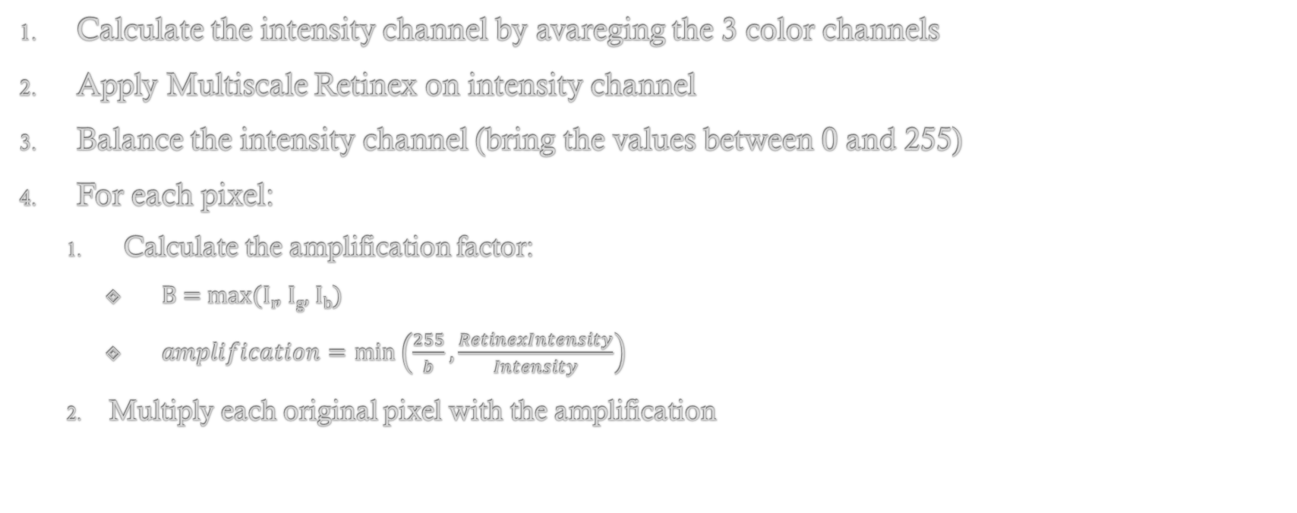
Multiscale Retinex Chromaticity Preservation (MSRCP)
Calculate the intensity channel by avareging the 3 color channels
Apply Multiscale Retinex on intensity channel
Balance the intensity channel (bring the values between 0 and 255)
For each pixel:
Calculate the amplification factor:
B = max(I_{r}, I_{g}, I_{b})
$amplification=\min\left(\frac{255}{b},\frac{RetinexIntensity}{Intensity}\right)$
Multiply each original pixel with the amplification

Slide 6
Results
Most of the time MSRCP performs better, but for images with a correct color distribution and white lightning, the result of applying MSRCR better preserves the color distribution

Slide 7
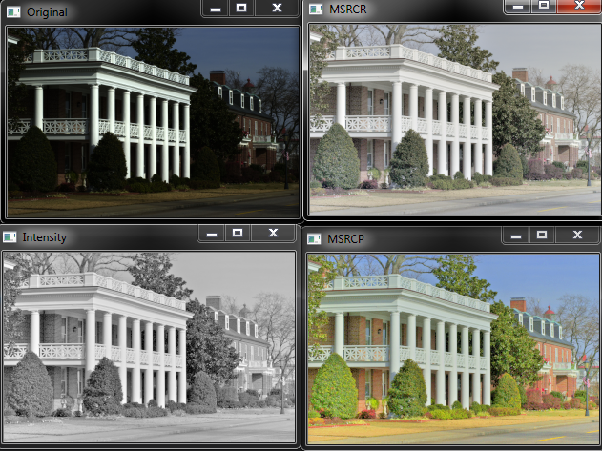
Results

Slide 8
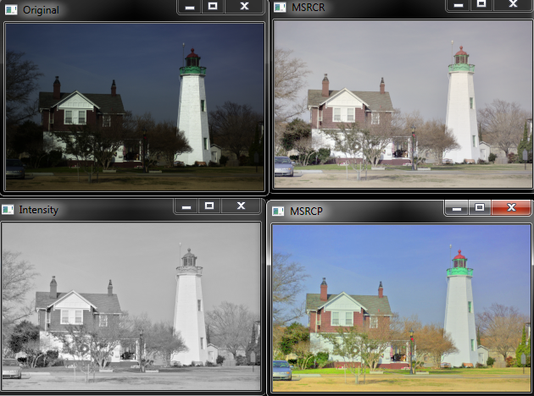
Results

Slide 9
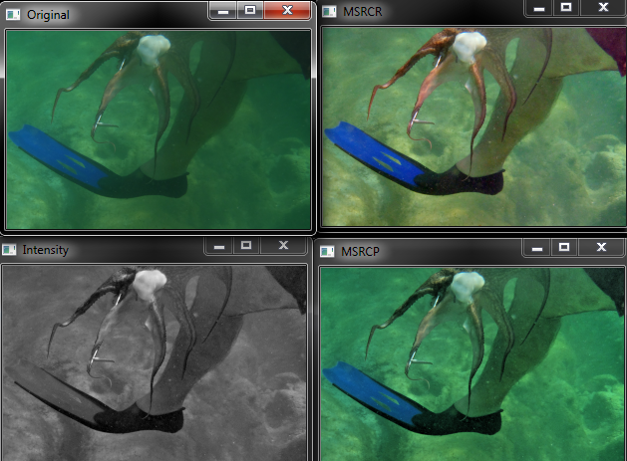
Results

Slide 10
References
Multiscale Retinex by Ana Bel´en Petro , Catalina Sbert , Jean-Michel Morel (2013)
Color Correction by Estimation of Dominant Chromaticity in Multi-Scaled Retinex by In-Su Jang, Kee-Hyon Park and Yeong-Ho Ha (2009)

